Slide 1




COURIER MANAGEMENT SYSTEM
Presented By:
1.PARTHIBAN S(510419104051),CSE,AEC
2.MOHAN RAJ M (510419104047), CSE, AEC
3.RAJESH E(510419104055),CSE,AEC
4.PRAGADEESHWARAN G(510419104053),CSE,AEC
Supervisor:
MR.G.NANDA KUMAR M.E.,
AP/CSE,
ARUNAI ENGINEERING COLLEGE.
DEPARTMENT OF
CSE

Slide 2
ABSTRACT
It is now-a-days very important for the people to send or receive articles like imported furniture, electronic items, gifts, business goods and the like. People depend vastly on different transport systems which mostly use the manual way of receiving and delivering the articles.
There is no way to track the articles till they are received and there is no way to let the customer know what happened in transit, once he booked some articles. In such a situation, we need a system which completely computerizes the cargo activities including time to time tracking of the articles sent.
This need is fulfilled by Courier Management System software which is online software for the cargo management people that enables them to receive the goods from a source and send them to a required destination and track their status from time to time.

Slide 3
INTRODUCTION
Courier Management System is software for the cargo offices where the customer can approach the office and book an article or good.
The manager/clerk can use this software to enter the details of the customer and goods along with the source and destination points.
The details of loading the goods into the physical transport system are also recorded by the system.
The system has GUI for the users to manage not only daily transactions but also to keep the historical data in the database for future reference.

Slide 4
EXISTING SYSTEM
The existing system is not totally automated.
Though the system is computerized to a particular extent, it has to do a lot of manual work.

Slide 5
LIMITATIONS
The entire database is maintained manually which is rather tedious and error prone.
Time delay is more because of verification of many records for generating reports, answering queries etc.
Queries are not answered properly due to lack of communication.
More space is required to keep all the records.
Improper interface.

Slide 6
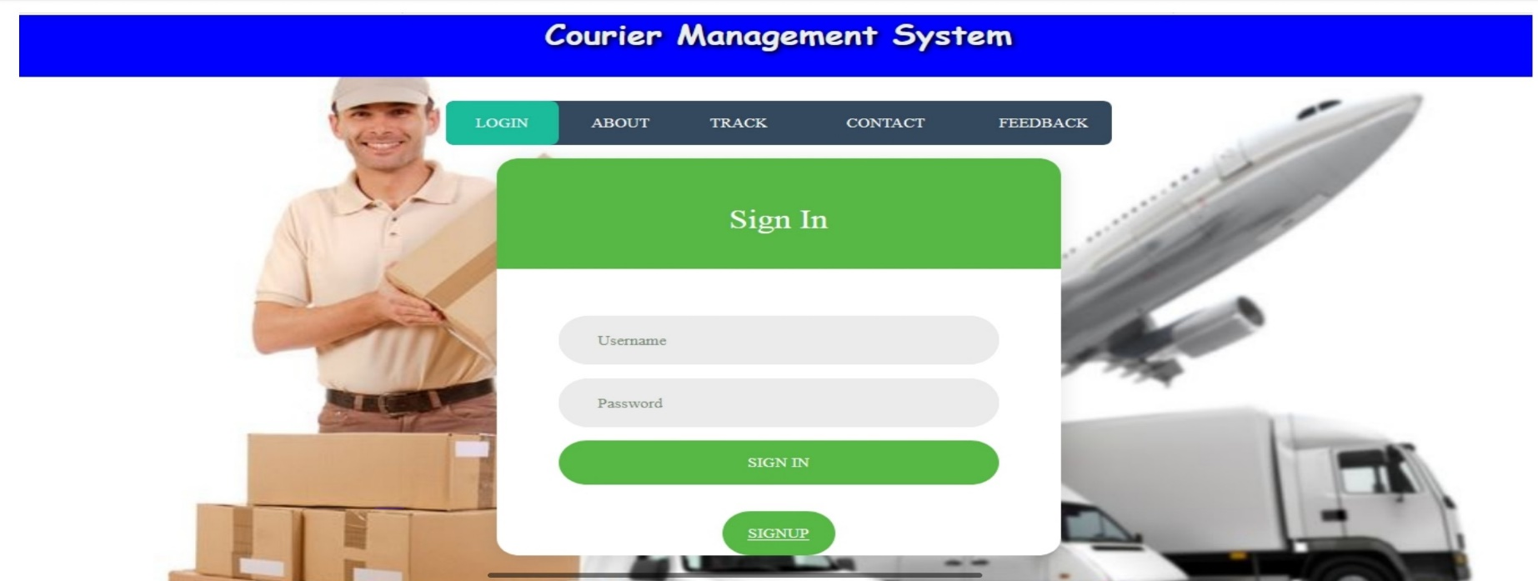
PROPOSED SYSTEM
Proposed system is a software application which avoids more manual hours that need to spend in record keeping and generating reports.
This application keeps the data in a centralized way which is available to all the users simultaneously.
It is very easy to manage historical data in database.

Slide 7
ADVANTAGES
Easy in maintaining information: As new information is being added to and released from their respective courses every year, it will be highly user friendly to track and maintain the presentation of all students.
User satisfaction: The system is such that is stands up to the user expectations like easy and faster retrieval of information.
Safety: The system will be accessible by only the authorized users. As information being the most crucial for the organization, then the safety of information is importation.

Slide 8
SYSTEM SPECIFICATION
SOFTWARE REQUIREMENTS
Operating system : Windows 7/10
Tool :Sublimetext/Notepad++
TECHNOLOGIES USED
Scripting Language : PHP
DATABASE
Data Base : MYSQL/PHP MYADMIN

Slide 9
HARDWARE REQUIREMENTS
System : Pentium IV 2.4 GHz.
Hard Disk : 40 GB.
Monitor : 15 VGA Colour.
Mouse : Logitech.
RAM : 512 Mb.

Slide 10
MODULES
ADMIN MODULE
Dashboard: In this section, admin can see all detail in brief like total courier, Total Courier Pickup, Total Shipped, Total In-transit, Total Courier arrived at the destination, Total courier out for delivery and Total delivered courier.
Branches: In this section, admin can manage branches (add and update).
Staffs: In this section, admin can manage Staffs (add, update and delete).
Courier: In this section, admin can view courier status and check the courier detail which is filling by the staff of different branches.
Reports: In this section admin can view courier details, courier counts and sales report according to dates.

Slide 11
STAFF MODULE
Dashboard: In this section, staffs can see all detail in brief like total courier, Total Courier Pickup, Total Shipped, Total In-transit, Total Courier arrived at the destination, Total courier out for delivery and Total delivered courier.
Add Courier: In this section, staffs fill the courier detail of parcel.
Status: In this section, staffs can view the courier details and they have also right to change courier status according to current status.

Slide 12
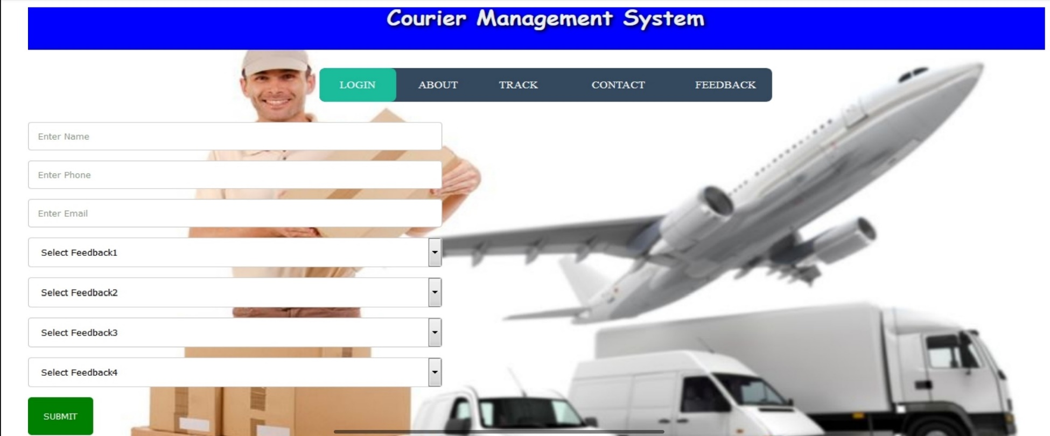
USER MODULE
In this module, user can view the current delivery status of his parcel by tracking/reference number and also view the different branches of Courier Company

Slide 13
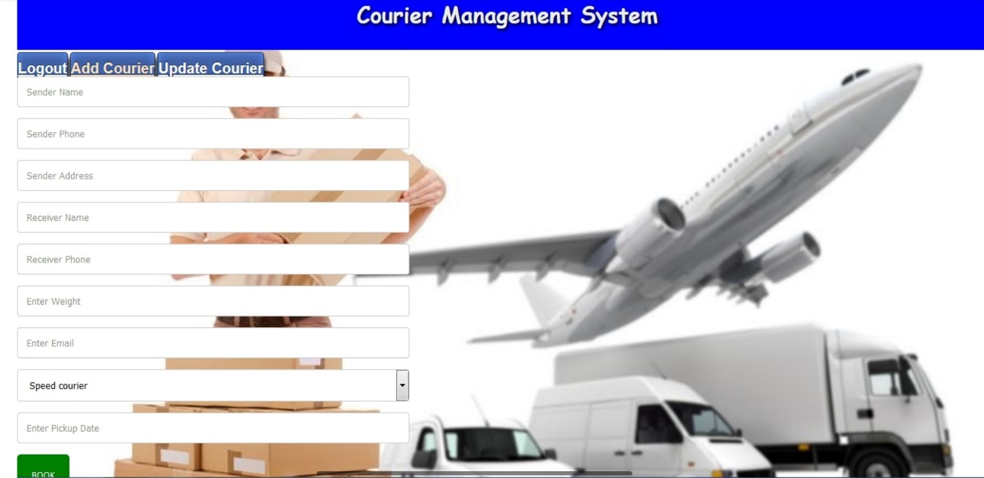

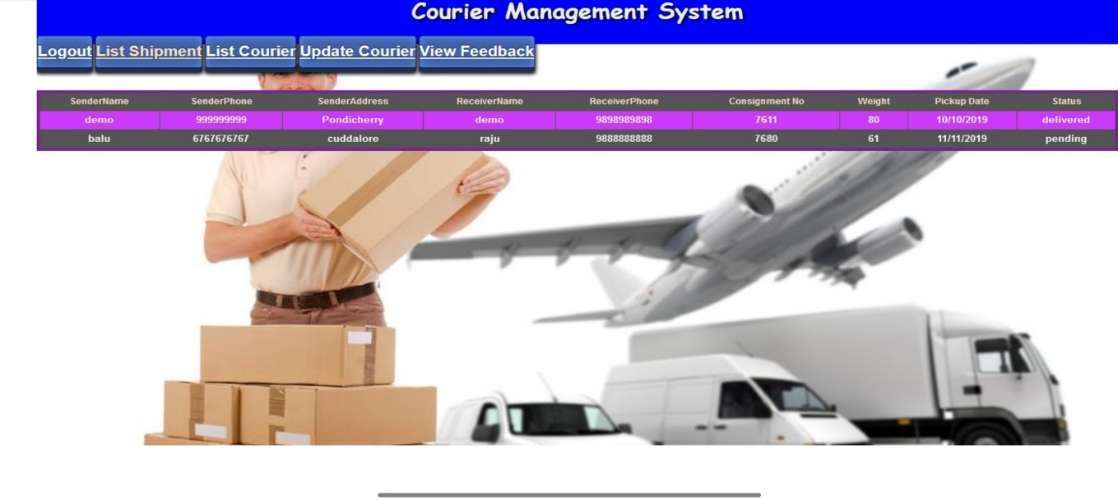
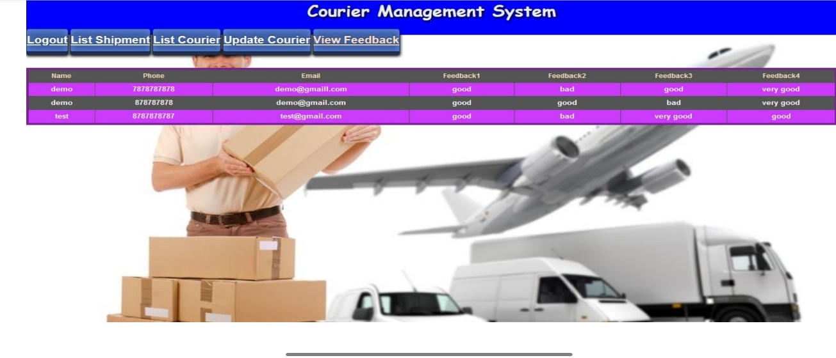
OUTPUT SCREENSHOTS

Slide 14
CONCLUSION
The entire project has been developed and deployed as per the requirements stated by the user, it is found to be bug free as per the testing standards that is implemented.
Any specification-untraced errors will be concentrated in the coming versions, which are planned to be developed in near future.
The system at present does not take care off the money payment methods, as the consolidated constructs need SSL standards and are critically to be initiated in the first face, the application of the credit card transactions is applied as a developmental phase in the coming days.
The system needs more elaborative technicality for its inception and evolution.

Slide 15
REFERENCE
L. DESCHENE, What is behavioral targeting? CBSNews, http://www.cbsnews.com/8301-505125_162-51199800/what-is-behavioraltargeting/?tag=bnet, accessed December 2011, May 2008.
WIX LEARNING CENTER, The advantages of online advertising vs. traditional methods. Wix Learning Center, http://www.wix.com/flash/web-design/learningcenter/promoting-your-website/the-advantages-of-online-advertising-vs-traditionalmethods.html, accessed January 2012, n. d.
JOHN WANAMAKER, Special: The advertising century. AdvertisingAge, http://adage.com/century/people006.html, accessed January 2012, March 1999.
WIKIPEDIA, Ad serving. Wikipedia, http://en.wikipedia.org/wiki/Ad_serving, accessed November 2011, n. d.
BROWSER MEDIA, DoubleClick deal means Google controls 69% of the online ad market. Browsermedia, http://www.browsermedia.co.uk/2008/04/01/doubleclickdeal-means-google-controls-69-of-the-online-ad-market/, accessed January 2011, April 2008.

Slide 16
COURIER MANAGEMENT SYSTEM
THANK YOU !!!
DEPARTMENT OF
CSE

